Slide 1

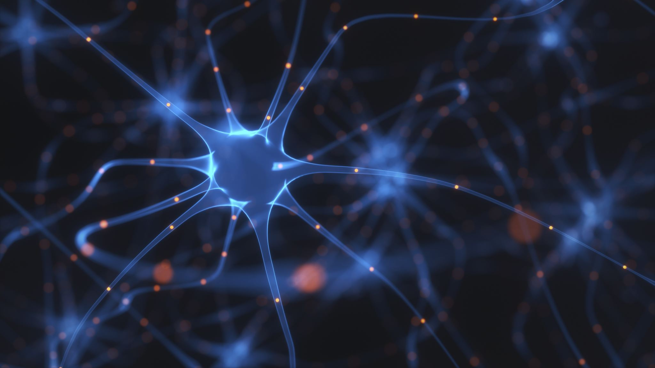
Predicting Brain Tumor Using MRI Scanned Image
By Mayank Dubey
G01220775

Slide 2


Introduction
“A brain tumor is a collection or mass, of abnormal cells in your brain”
There are two types of brain tumor malign or benign
Malign are cancerous and grows fast and Benign are non-cancerous and grows slow.
The most common way of detecting brain tumor is MRI (Magnetic resonance imaging).
The MRI images are given to the Neurologist who decides the tumor is benign or malign.
The aim of the project is to build a model given the image of a person decides whether person has tumor or not.

Slide 3

Data Introduction
Data is labelled – Supervised learning.
It is a Binary classification problem. Yes means tumor (1) and No means no tumor (0).
There are total 253 images.

Slide 4


Model Evaluation
Confusion Matrix = $\left[\begin{matrix}TP & FN \\ FP & TN\end{matrix}\right]$
Precision = $\frac{TP}{TP+FP}$
Recall = $\frac{TP}{TP+FN}$
Accuracy = $\frac{TP+TN}{TP+TN+FP+FN}$
Roc - Plot between TRP and FPR
AUC - Area under curve.

Slide 5
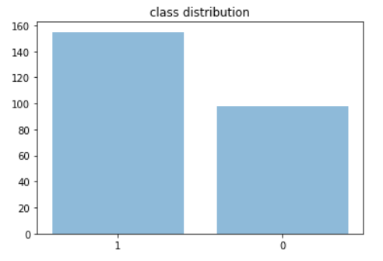
EDA
Total 253 images
Images has different shape.
Black & White Image (2d)
Pixel value ranges from 0 to 255
0- white, 255 - black
155 has tumor
98 has no tumor

Slide 6
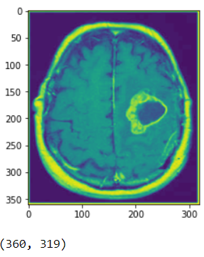
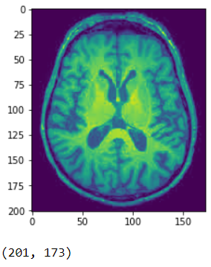
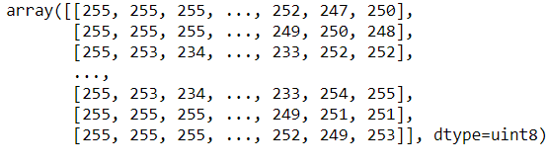
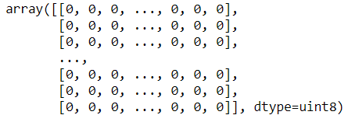
Cont.
Tumor
Not tumor

Slide 7
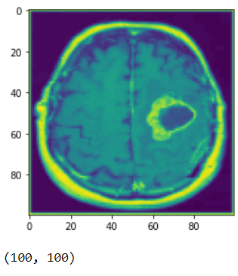
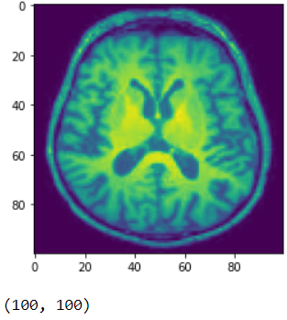
Data preprocessing
Converting every image into 100 * 100 form.
Train Test Split.
202 Training Images, 51 Testing images.
Flattening the data.

Slide 8
Modeling
Logistic Regression
Random Forest
Deep Neural Network
Convolutional Neural Network

Slide 9
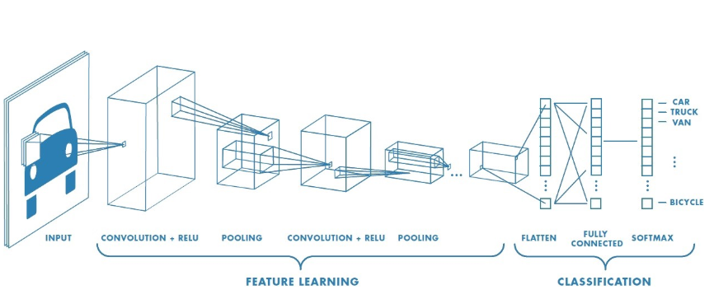
CNN Architecture
Convolution layer is for extracting features from input.
Convolution layer preserves the relationship between pixel by not flattening up front.
Convolution is a mathematical operation between image and kernel.

Slide 10
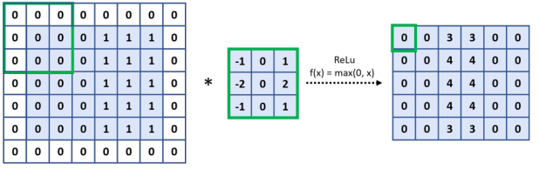
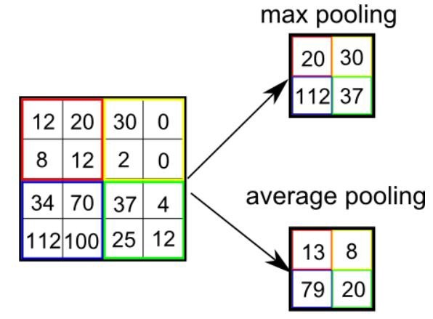
CNN Operation
1st is convolution layer and activation layer
2nd is pooling.

Slide 11
Important
FN should be less (ideally 0)
Recall should be more
(ideally 1)

Slide 12
How to do that?

Slide 13
Easiest way to make FN = 0 and Recall = 1
FN = 0, Recall =1
Problem with that
To say everyone has brain tumor.
It will increase FP
TN will be 0.
Accuracy will be too low.
We don’t need model do that.
Not cost effective.

Slide 14
Comparing Performance of algorithm.
Algorithm | Accuracy | AUC | Precision | Recall | TP | TN | FP | FN
Base model | 0.52 | - | 0.52 | 1.0 | 27 | 0 | 24 | 0
Logistic Regression | 0.78 | 0.81 | 0.75 | 0.88 | 24 | 16 | 8 | 3
Random Forest | 0.82 | 0.89 | 0.80 | 0.88 | 24 | 18 | 6 | 3
Neural Network | 0.83 | 0.78 | 0.75 | 0.88 | 24 | 16 | 8 | 3
CNN | 0.66 | 0.72 | 0.62 | 0.92 | 25 | 9 | 15 | 2

Slide 15
Index of the Images which gave FN
ALGORITHM | Index | Index | Index
LOGISTIC REGRESSION | 8 | 18 | 36
RANDOM FOREST | 8 | 18 | 46
NEURAL NETWORK | 8 | 18 | 36
CNN | 8 | 18

Slide 16
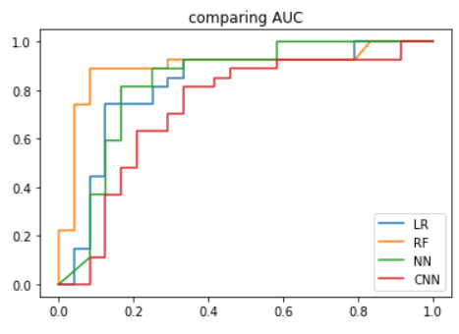
AUC

Slide 17
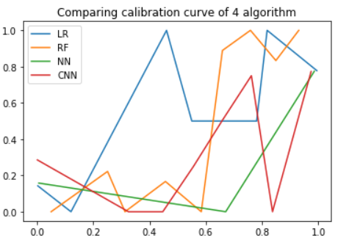
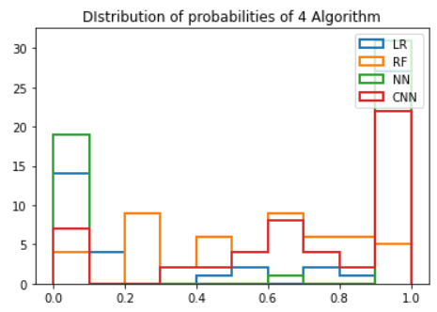
Calibration curve and probability distribution

Slide 18
MODELING 2
Normalizing the images.
Every pixel value is divided by 255.
Max value for pixel in black & white images is 255.
Which converts pixel value between 0 and 1.

Slide 19
Comparing Performance
Algorithm | Accuracy | AUC | Precision | Recall | TP | TN | FP | FN
Logistic Regression | 0.80 | 0.83 | 0.77 | 0.88 | 24 | 17 | 7 | 3
Random Forest | 0.78 | 0.88 | 0.75 | 0.88 | 24 | 16 | 8 | 3
Neural Network | 0.78 | 0.86 | 0.76 | 0.85 | 23 | 17 | 7 | 4
CNN | 0.82 | 0.82 | 0.82 | 0.85 | 23 | 19 | 5 | 4

Slide 20
Index of the Images which gave FN
Algorithm | index | index | Index
LOGISTIC REGRESSION | 8 | 15 | 18
RANDOM FOREST | 8 | 18 | 46
NEURAL NETWORK | 8 | 15 | 18 | 36
CNN | 8 | 18 | 37 | 46

Slide 21
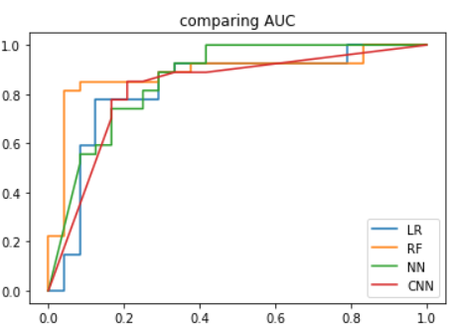
AUC

Slide 22
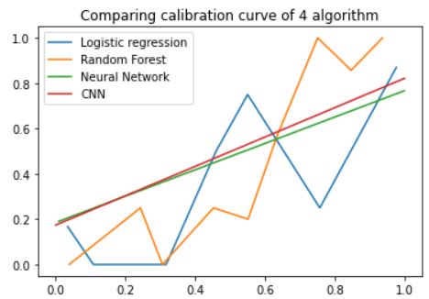
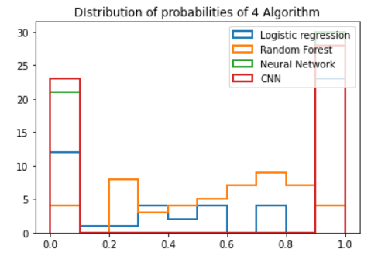
Calibration curve and probability distribution

Slide 23
Modeling 3
Blurring the images.
Gaussian Blur, which DOES 100% BLURING.
Blurring is done on training data.
Testing is done on unblur data.

Slide 24
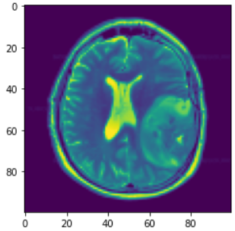
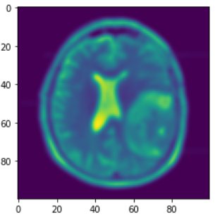
EDA
NORMAL IMAGE
BLUR IMAGE

Slide 25
Comparing Performance
Algorithm | Accuracy | AUC | Precision | Recall | TP | TN | FP | FN
Logistic Regression | 0.72 | 0.79 | 0.69 | 0.85 | 23 | 14 | 10 | 4
Random Forest | 0.80 | 0.88 | 0.79 | 0.85 | 23 | 18 | 6 | 4
Neural Network | 0.74 | 0.81 | 0.71 | 0.85 | 23 | 15 | 9 | 4
CNN | 0.82 | 0.80 | 0.80 | 0.88 | 24 | 18 | 6 | 3

Slide 26
Index of the Images which gave FN
Algorithm | index | index | Index | index
LOGISTIC REGRESSION | 1 | 8 | 18 | 46
RANDOM FOREST | 8 | 15 | 18 | 46
NEURAL NETWORK | 8 | 8 | 18 | 36
CNN | 8 | 18 | 38

Slide 27
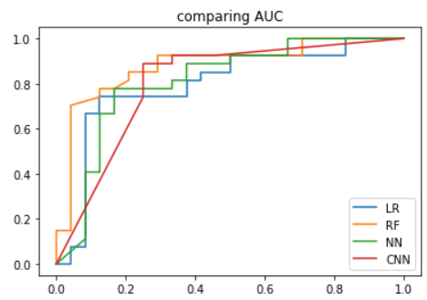
AUC

Slide 28
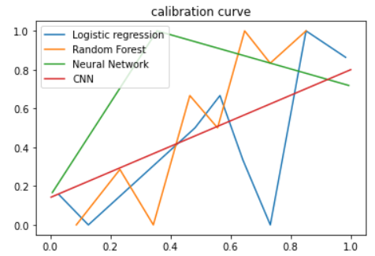
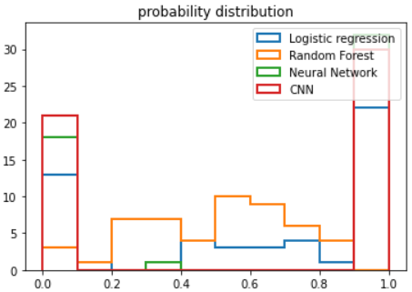
Calibration curve and probability distribution

Slide 29
Modeling 4
Rotating blur images.
Original blur,
90 degrees,
180 degrees,
270 degrees rotation.
Training model on noise.
X_train = 808

Slide 30
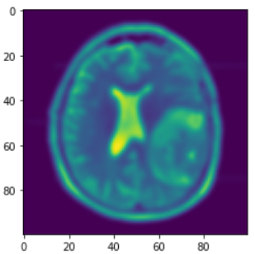
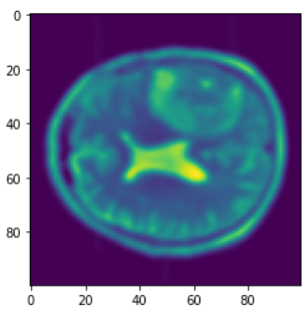
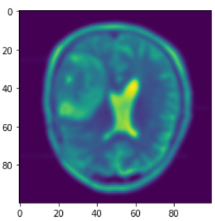
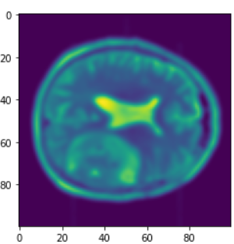
EDA

Slide 31
Comparing Performance
Algorithm | Accuracy | AUC | Precision | Recall | TP | TN | FP | FN
Logistic Regression | 0.62 | 0.71 | 0.62 | 0.74 | 20 | 12 | 12 | 7
Random Forest | 0.76 | 0.87 | 0.75 | 0.81 | 22 | 17 | 7 | 5
Neural Network | 0.74 | 0.78 | 0.70 | 0.88 | 24 | 14 | 10 | 3
CNN | 0.80 | 0.82 | 0.77 | 0.88 | 24 | 17 | 7 | 3

Slide 32
Index of the Images which gave FN
Algorithm | index | index | Index | index
LOGISTIC REGRESSION | 8 | 17 | 18 | 22 | 23 | 36 | 46
RANDOM FOREST | 8 | 15 | 18 | 38 | 46
NEURAL NETWORK | 8 | 18 | 36
CNN | 8 | 18 | 37

Slide 33
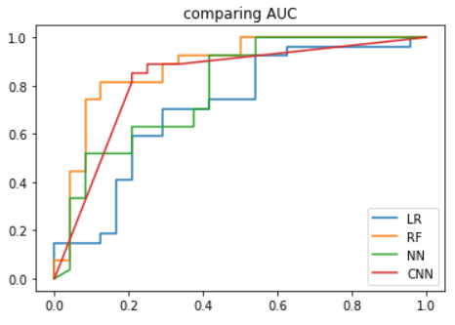
AUC

Slide 34
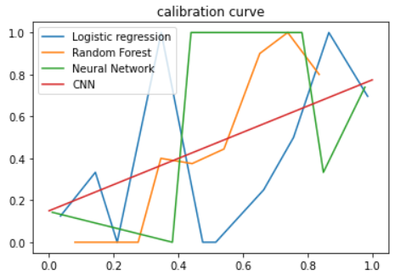
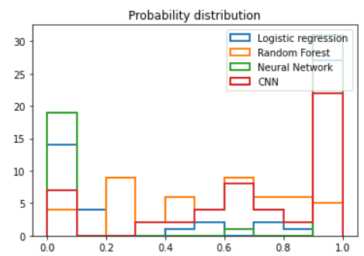
Calibration curve and probability distribution

Slide 35
MODELING 5
Rotating original image 90, 180, 270 degrees.
Rotating blur image 90, 180, 270 degrees.
X_train = 1616

Slide 36
Comparing Performance
Algorithm | Accuracy | AUC | Precision | Recall | TP | TN | FP | FN
Logistic Regression | 0.64 | 0.70 | 0.65 | 0.70 | 19 | 14 | 10 | 8
Random Forest | 0.82 | 0.88 | 0.82 | 0.85 | 23 | 19 | 5 | 4
Neural Network | 0.52 | 0.43 | 0.52 | 1.0 | 27 | 0 | 24 | 0
CNN | 0.81 | 0.76 | 0.74 | 0.85 | 23 | 16 | 8 | 4

Slide 37
INDEX WHICH GAVE FN
Algorithm | Index | Index | Index | Index | Index | Index | Index | Index
LOGISTIC REGRESSION | 8 | 17 | 18 | 22 | 23 | 36 | 39 | 46
RANDOM FOREST | 8 | 18 | 38 | 46
NEURAL NETWORK | 8 | 15 | 18 | 46 | 47
CNN | 8 | 18 | 21 | 37

Slide 38
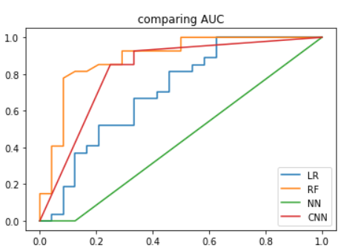
AUC

Slide 39
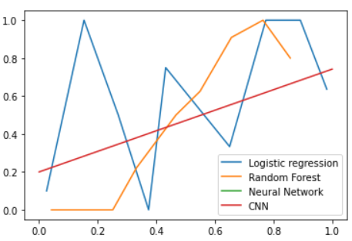
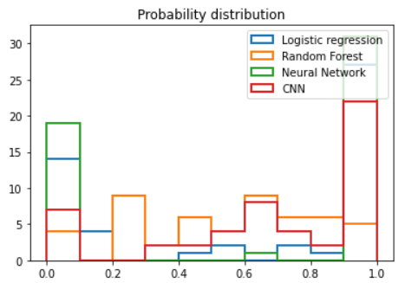
CALIBRATION

Slide 40

Why to add noise?
To create more training example.
To make model generalized.

Slide 41
CONCLUSION
On the original training data every algorithm performs almost same.
As the noise is added CNN and Random Forest performs better.
CNN gives the most calibrated model.

Slide 42
Thank you

